Slide 1







Intellectual property as an export driver of economic growth: A view from China
Yu “Uny” CAO, Ph.D.
Interdepartmental Communication Platform on Innovative Development
21 November 2024

Slide 2




A technologist and an inventor for 1/4 century.
Focuses on IP and Technical Assets.
Grew up in Hangzhou, China. Spent years in Los Angeles, New Jersey in the United States.
Degrees were in engineering, from Zhejiang University (浙江大学) in Hangzhou, China, University of Louisville, and UCLA (University of California at Los Angeles) in the United States.
Yu “Uny” CAO, PhD
Executive Vice President,
Zhejiang Intellectual Property Exchange Center Ltd.
Hangzhou, China

Slide 3






1.
The Zhuhai Air Show: China exports military hardware

Slide 4

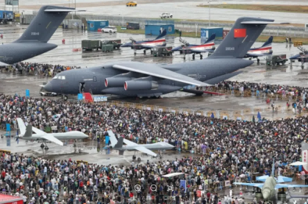
The 2024 Zhuhai Air Show
November 12th-17th, 2024.
The Zhuhai Airshow:
officially known as the China International Aviation and Aerospace Exhibition.

Slide 5
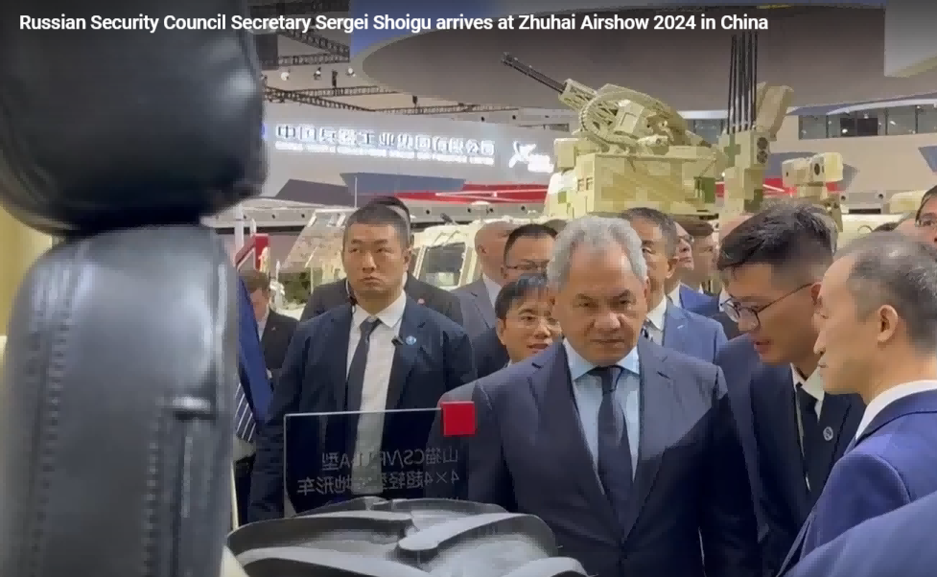

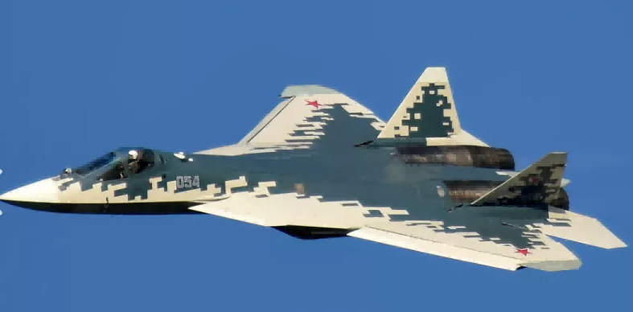
The 2024 Zhuhai Air Show
The VIPs.
Su-57 fighter jets,
and the test pilot Sergey Bodan.

Slide 6
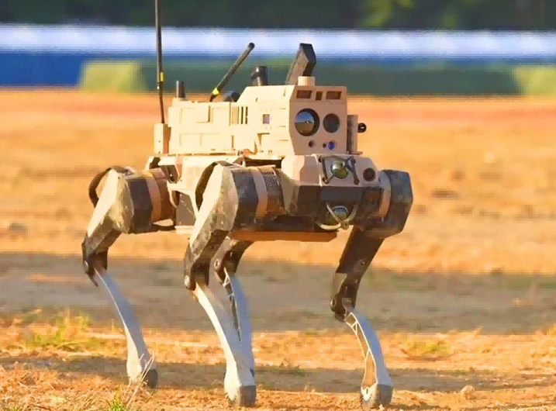
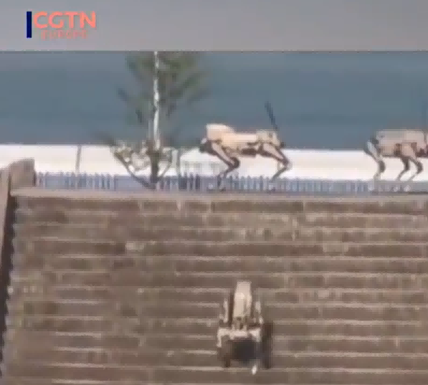
The Zhuhai Air Show
Robo-wolves, forming self-moving military teams

Slide 7

2.
Indicators of IP driving China’s economic growth

Slide 8
China’s boom in high-tech export
China's "New Three" exports:
  Batteries,
  Electric vehicles,
  Solar panels.
In 2023, exports of these products exceeded RMB 1 trillion yuan (approximately 128 billion euros), marking a 29.9% increase.

Slide 9

Innovative cities
2 | Shenzhen-Hong Kong-Guangzhou | 深圳-香港-广州 | 47 | Harbin | 哈尔滨
3 | Beijing | 北京 | 49 | Jinan | 济南
5 | Shanghai-Suzhou | 上海-苏州 | 58 | Changchun | 长春
9 | Nanjing | 南京 | 61 | Shenyang | 沈阳
13 | Wuhan | 武汉 | 65 | Dalian | 大连
14 | Hangzhou | 杭州 | 68 | Zhengzhou | 郑州
18 | Xi’an | 西安 | 72 | Xiamen | 厦门
20 | Qingdao | 青岛 | 77 | Zhenjiang | 镇江
23 | Chengdu | 成都 | 80 | Lanzhou | 兰州
32 | Changsha | 长沙 | 85 | Fuzhou | 福州
34 | Tianjin | 天津 | 94 | Nanchang | 南昌
36 | Hefei | 合肥 | 98 | Kunming | 昆明
39 | Chongqing | 重庆 | 100 | Macao SAR-Zhuhai | 澳门-珠海
Top 100 Science and Technology Clusters of 2024, by the World Intellectual Property Organization's (WIPO).
For the second time, China surpassed the United States. Chinese cities are 1/4 of the top 100, and American cities 1/5.

Slide 10

WIPO: China is the runaway leader in generative AI patent applications
For the decade starting in 2014:
  More than 38,200 generative AI inventions came from China.
  Nearly 6,300 from the United States.
  South Korea with 4,155. Japan with more than 3,400. India with 1,350.
[World Intellectual Property Office (WIPO). July 2024]

Slide 11
3.
How has IP driven the economic growth in the last 20 yeas in China?

Slide 12
The major roles
The governments at all levels:
  Set policies, and “educate the market”.
The universities and research institutes:
  Pushed by governments for university technology transfer.

Slide 13
The major roles
The businesses and the entrepreneurs know the best:
  Businesses need invention patents to protect.
  Businesses need invention patents, in order to apply for various certifications. These certifications lead to many benefits.
  Businesses can obtain IP-backed financing.
  Businesses compete in IP awards.

Slide 14
The major roles
Data as a new entry:
  Data Intellectual Property, a new type of intellectual property since 2022.
  The ministry of Finance allows companies to put Data as an asset in balance sheets since January 2024.

Slide 15
4.
Efforts by governments at all levels

Slide 16
Size of China’s research spending
On the topic of the world leader in research spending
“We think that China may have overtaken the U.S. at some point in 2019,” acknowledges the National Science Board. (2020-01)

Slide 17
A nation-wide system for technological innovation
The annual report by the National Development and Reform Commission (国家发改委) in May 2020 wrote:
  Work faster to achieve breakthroughs in core technologies in key fields.
  Build a new nation-wide system for breakthroughs in key core technologies under the conditions of a socialist market economy.

Slide 18
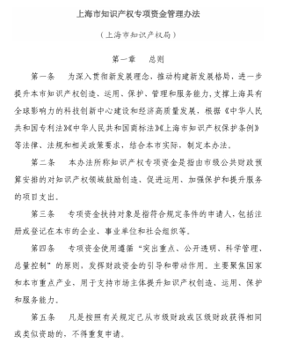
The governments at all levels, set policies and “educate the market”
For an example, here is Shanghai’s policies on intellectual property. Management Measures for Shanghai Intellectual Property Special Fund by Shanghai Intellectual Property Administration.
Article 2: The term "Intellectual Property Special Fund" as referred to in these Measures means the project expenditures arranged by the municipal public finance budget to encourage creation, promote utilization, strengthen protection, and enhance services in the field of intellectual property.

Slide 19
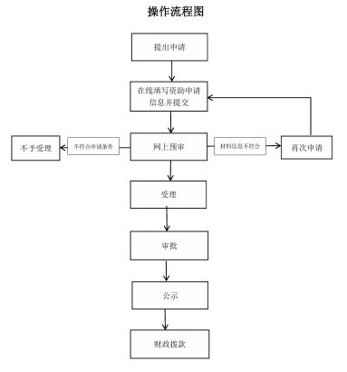
The governments at all levels, set policies and “educate the market”
Article 3: The target of special fund support refers to applicants who meet the specified conditions, including enterprises, institutions, and social organizations registered or recorded in this city.

Slide 20
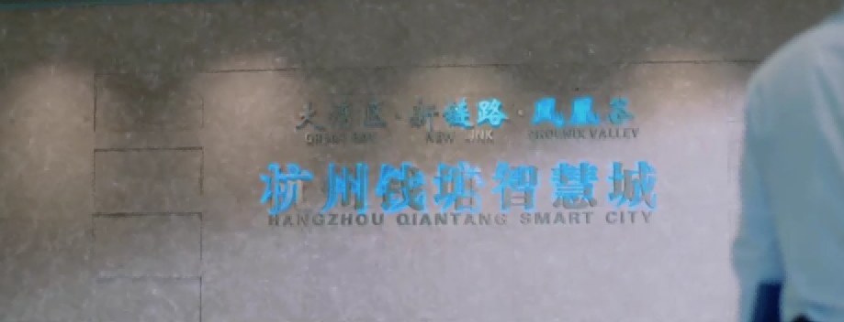

An example of a local government
Shangcheng District (杭州市上城区）offers a reward of 3% of the actual loan amount to enterprises that implement intellectual property pledge loans, with an annual cap of 500,000 RMB per company.
Provides a one-time subsidy of 500,000 RMB for companies that win the China Patent Gold Award, with additional funding available for patent commercialization projects.

Slide 21
An example of “talent programs”
A Talent Program at Zhejiang Province. Research funding support 200-400 million RMB (25-50 million euros) for top talents.
Top talents with global influence, such as members of national academies (e.g., Russian Academy of Sciences), recipients of international science and technology awards like the Nobel Prize, and recipients of top-level science and technology awards from countries such as the UK, Germany, and the USA.

Slide 22
5.
Push by governments for university technology transfer

Slide 23
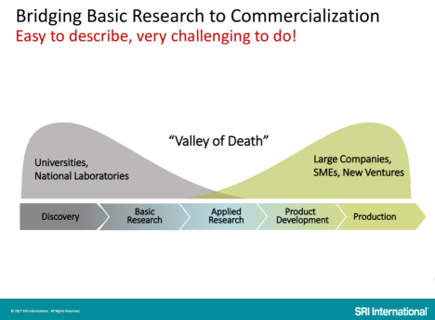
The “Valley of Death”
A diagram from SRI International of the U.S.

Slide 24
Tremendous growth in university-generated invention patents
As of the end of 2023, the total number of effective invention patents in colleges and universities reached 794,000, and the total number of effective invention patents in scientific research institutions reached 229,000. They account for 1/4 of the total number of effective invention patents. [Department of Intellectual Property Utilization and Promotion, National Intellectual Property Administration. 2024-02]
From 2012 to 2021, the number of granted patents in colleges and universities increased from 69,000 to 308,000 per year, and the number of patent ownership transfers and licenses increased from 2,357 to over 15,000, with the financial amounts of patent transfers increased from 820 million yuan to 8.89 billion yuan. [Ministry of Education. 2022-08]

Slide 25
Pushing commercialization of university research
The two main government agencies have been
  The Ministry of Science and Technology (MST) of China; and
  China National Intellectual Property Administration (CNIPA), formerly known as the State Intellectual Property Office (SIPO).

Slide 26

Law on “Science and Technology Achievements Transformation”
The national law "Promotion of Science and Technology Achievements Transformation Law", amended in 2015.
The law aims to facilitate the conversion of scientific and technological achievements into actual productive forces, regulate the process of transformation.
Much of the work was carried out at the province-level, by the Department of Science and Technology at each province.

Slide 27
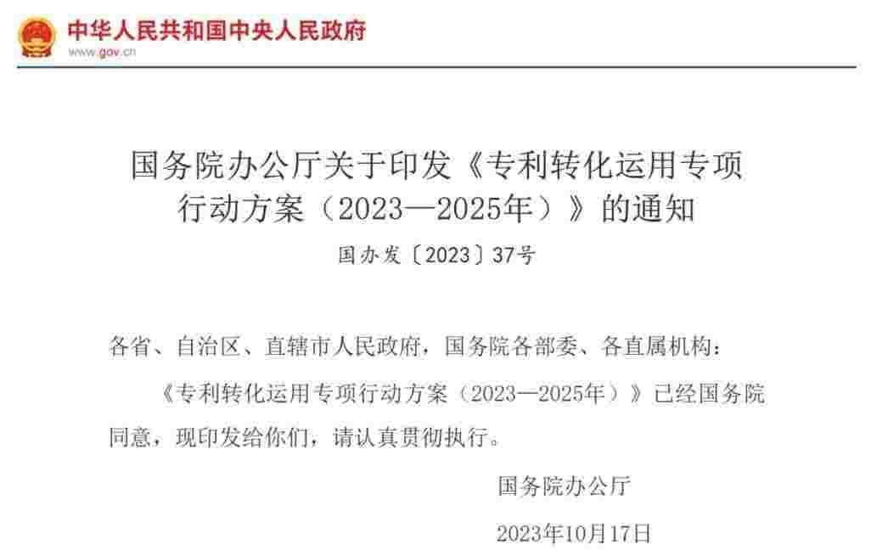
A 3-year action plan at the national level
In October 2023, the State Council of China issued the "Special Action Plan for the Transformation and Application of Patents (2023-2025)".
One measure clarifies that "for patents that have been granted for more than 5 years without implementation and without justifiable reasons, the state may implement them without compensation, or license others to implement them with or without compensation, to promote the output and implementation of high-value patents from scientific research projects funded by the government."

Slide 28
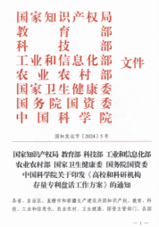
Revitalizing the Stock of Patents in Universities and Research Institutions
The Intellectual Property offices started to get involved in university technology transfer.
January 2024, the China National Intellectual Property Administration issued the "Work Plan for Revitalizing the Stock of Patents in Universities and Scientific Research Institutions" :
  Proposes a four-step process: comprehensive inventory, market evaluation, promotion and transformation, and optimization of new increments.

Slide 29
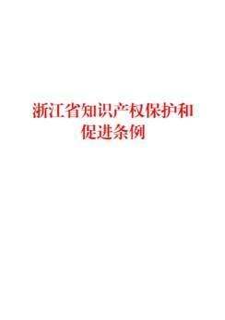
The Patent Public Implementation polices in Zhejiang Province since 2023
A 2023 law at the province stipulated the Patent Public Implementation.
Patents from scientific and technological research projects established by colleges and universities and scientific research institutions with fiscal funds, if not implemented for three years without justifiable reasons from the date of the grant of the patent, should be included in the public implementation list.

Slide 30
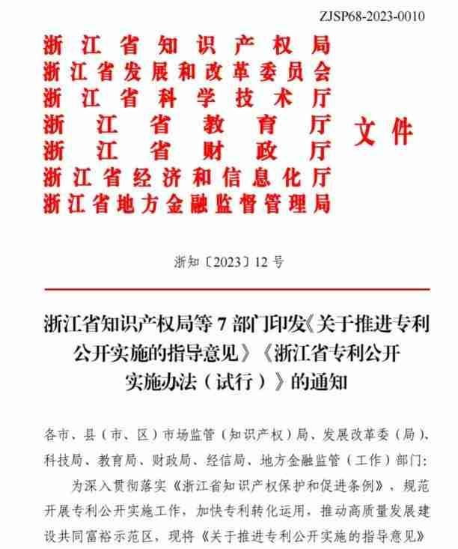
The Patent Public Implementation polices in Zhejiang Province since 2023
Relevant departments swiftly introduced the "Guiding Opinions on Promoting the Public Implementation of Patents" and the "Zhejiang Province Patent Public Implementation Measures (Trial)".
Establish a work system, policy system, and service system.

Slide 31

The Patent Public Implementation polices in Zhejiang Province since 2023
Our company, Zhejiang Intellectual Property Exchange Center Ltd., is involved in the work system and service system.
Our implementations have been directed by Zhejiang Provincial Administration of Intellectual Property.

Slide 32
A few words on Zhejiang Intellectual Property Exchange Center
The only financial exchange in Zhejiang province for intellectual property transactions.
Approved by the Zhejiang Provincial Government in 2016, initiated by the provincial Department of Science and Technology, and Zhejiang University.
Regulated by the provincial Administration of Financial Regulation.
Directed by the provincial Administration of Intellectual Property.
Engaged in Data Intellectual Property.

Slide 33
5.
Data Intellectual Property, and
Data as an Asset in Balance Sheets

Slide 34
Data as a new Production Factor
Data as a production factor, alongside the traditional factors of land, labor, capital and technology.
A View: Governments in China shift from the "Land Fiscal Policy" to the "Data Fiscal Policy" .
  According to a 2023 report by Soochow Securities Co., the scale of China's data asset market is in the tens of trillions yuan, thus is capable of taking over from the land fiscal policy.

Slide 35
Data Intellectual Property, a new type of IP for protecting data sets
In China, the initiative to "establish a Data Intellectual Property rights system" was outlined in October 2021 by the State Council's 14th Five-Year National Intellectual Property Protection and Utilization Plan.
Question: What protects data sets?

Slide 36
Data Intellectual Property, a new type of IP for protecting data sets
How to protect data sets?
  Data Intellectual Property (数据知识产权)
What is a Data Intellectual Property
  Data sets that are (a) legally collected, (b) processed through certain algorithms, and which (c) possess practical value and (d) the attributes of intellectual achievements.

Slide 37
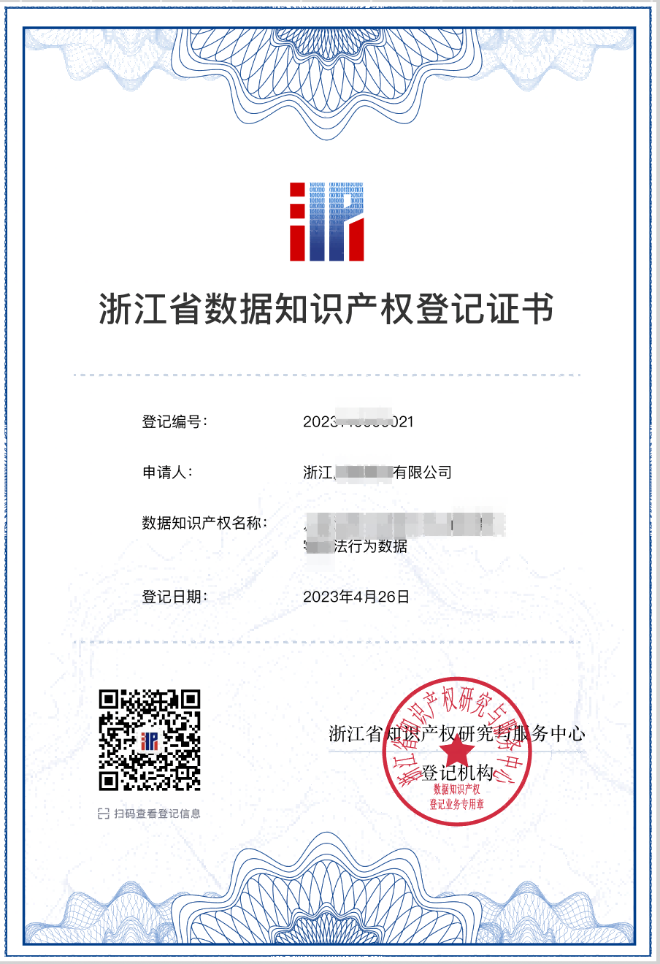
Data Intellectual Property, a new type of IP for protecting data sets
Data intellectual property rights has been piloted by the National Intellectual Property Administration since 2022.
As of early-November 2024, more than 12,000 cases have been registered in Zhejiang Province, accounting for about 80% of the national total.

Slide 38
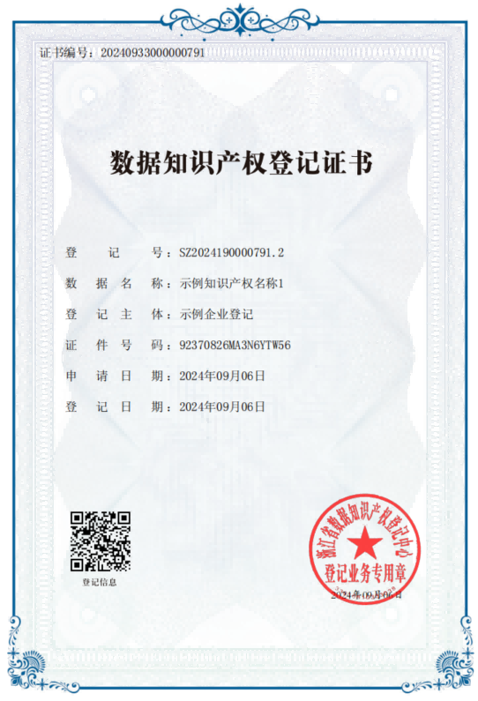
Data Intellectual Property, a new type of IP for protecting data sets
Both enterprises and individuals can be rights holders.
More than 1,700 enterprises have registered data intellectual property rights with Zhejiang Province.
An applicant can register one case, or dozens, or even hundreds. The company with the most registrations so far has registered nearly 1,000 cases.

Slide 39
Data Intellectual Property, a new type of IP for protecting data sets
In July 2024, the first legal case was decided that involved the judicial effectiveness of a data intellectual property registration certificate.
The courts decided that the "Data Intellectual Property Registration Certificate" can serve as (A) preliminary evidence of the property interests related to the data set claimed by a company, and as (B) preliminary evidence of the legality of the collection actions or data sources of the data set in question.

Slide 40



Thank you!
Yu “Uny” CAO, PhD
CAOYU@ZJIPX.com

